Slide 1

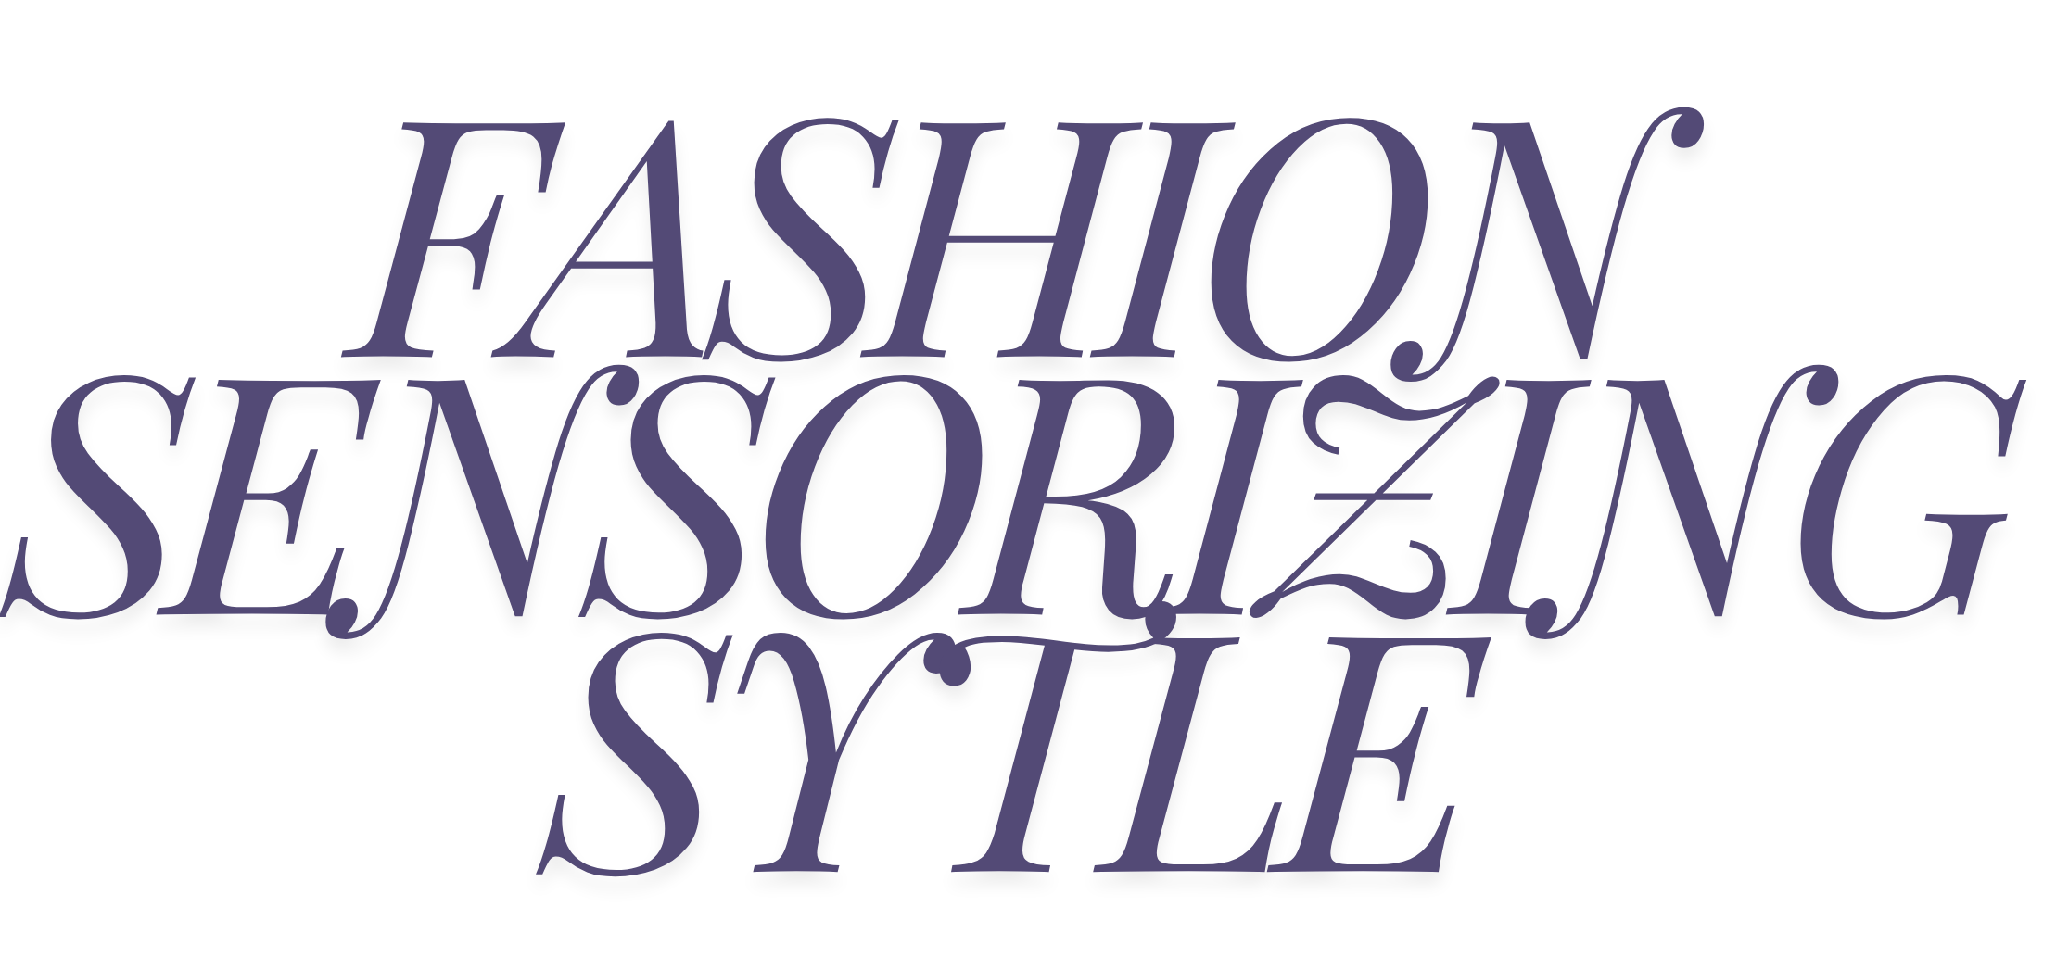
BADIGA HARSHITHA
ETIKALA ESHWITHASRI
GAHARWAR DIKSHITHA
JARUGULLA PRANATHI

Slide 2


Introduction
- Fashion sensors mix advanced tech with clothing and accessories.
They can track things like heart rate, body temperature, and movement.
They still look stylish and fashionable.
Make everyday outfits more personalized and high-tech.
Leading the way in wearable technology.

Slide 3


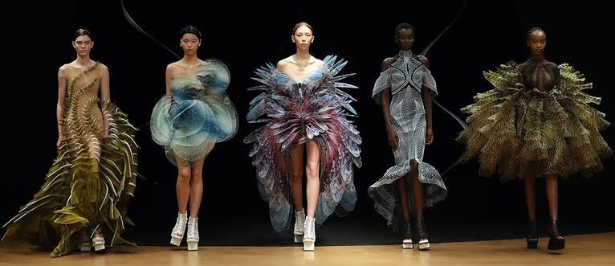
"Wearable Sensoring Using
Fashion Technology: A Fusion of Style and Functionality"
Over the past decade, wearable technology has come a long way, blending smoothly with the fashion world. This combination of style and practicality has given rise to advanced wearable sensors that do more than just track health and fitness—they also add a touch of personal flair.

Slide 4
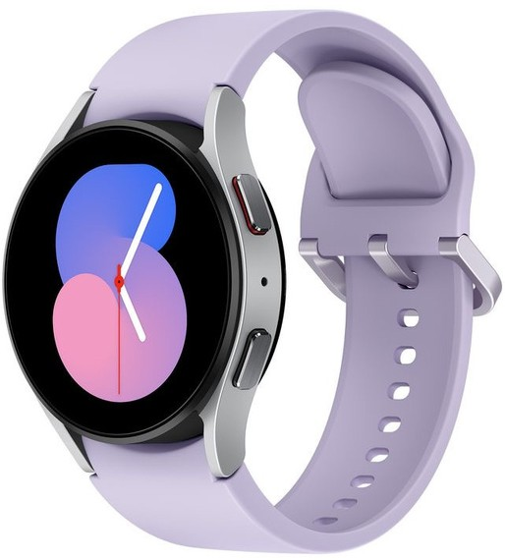
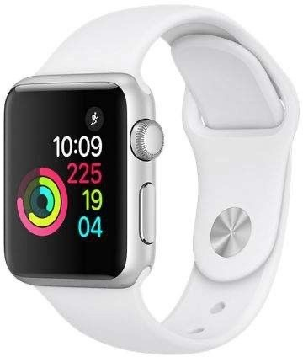
1. Early Innovations:
Fitness trackers, like Fitbit and Jawbone, started out by focusing on the basics: counting your steps, monitoring your heart rate, and keeping track of your sleep.
Smartwatches from Apple and Samsung took things a step further, adding cool features like ECG monitoring and blood oxygen level tracking.

Slide 5
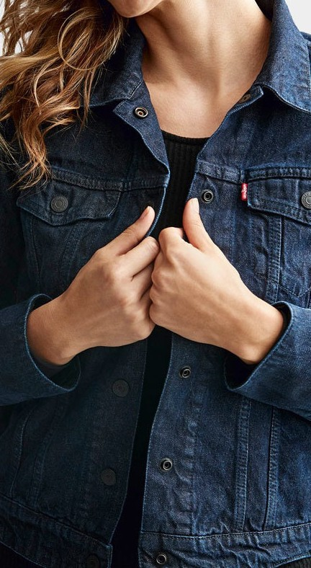
2. IntegratIon WItH FasHIon:
Smart textiles are fabrics that have digital components like sensors and microcontrollers woven into them. They can keep track of your body metrics and even monitor environmental conditions.
Tech companies are teaming up with fashion brands to create stylish gadgets. For example, Google worked with Levi's to make a smart jacket that looks great and offers advanced features.

Slide 6


Sensors:
Biometric Sensors:Measure heart rate, blood pressure, and glucose levels.
Motion Sensors: Track physical activity and movement patterns.
Environmental Sensors:Detect UV exposure, air quality, and temperature.

Slide 7

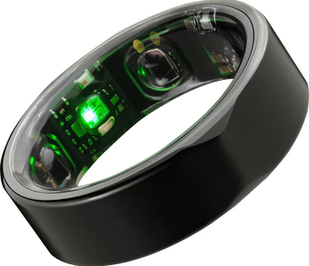
Applications of Wearable Fashion Technology
-Continuous Monitoring:Smart rings and bracelets can keep an eye on your vital signs all the time, alerting you to any potential health problems.
-Posture Correction: Smart shirts and undershirts give you real-time feedback on your posture, helping you stand and sit correctly.

Slide 8

Fitness trackers: These wearables often come in the form of wristbands, straps or headbands that monitor physical activity and vital signs.
Trackers may connect wirelessly to an app for data storage, processing and reporting.
VR headsets: VR headsets entirely replace
the user environment with digital information and endhance the fictional reality. VR users are controlled by the system.
Smart clothing has built-in tech for fitness and health monitoring, connecting to phones, and adapting to your needs. For instance, Tommy Hilfiger launched clothes with solar cells in 2014 to charge devices.

Slide 9

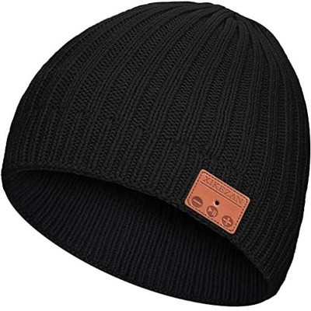
The Evolution of Wearable Sensors
A Bluetooth beanie is a type of hat or beanie that incorporates Bluetooth technology, allowing users to wirelessly stream music, take phone calls, or access voice assistants directly from their headwear.
Design: A Bluetooth beanie typically looks like a regular beanie or hat, but with built-in Bluetooth technology. It features integrated speakers and sometimes a microphone for hands- free calling.

Slide 10

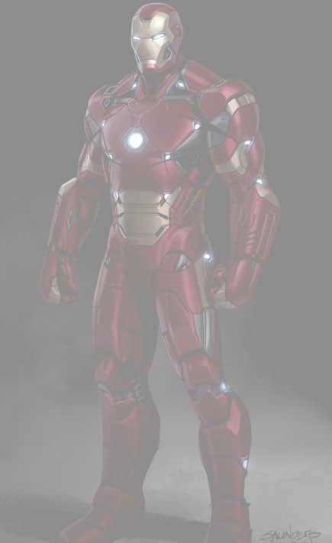

WEAPONS SYSTEMS
MODULAR DESIGN
ARMOR
FLY
Made of a unique alloy commonly referred to as "Iron Man armor," the suit offers remarkable resilience and defense against both energy- and physical- based assaults.
The Iron Man suit's ability to maintain high-speed flight is one of its most recognizable features. Agile aerial maneuvers are made possible by the suit's jet thrusters, which are powered by miniature arc reactor technology.
The suit has a plethora of offensive armament, such as missiles, unibeams, and repulsor blasts, which are energy beams that shoot out of the palms and chest, respectively.
The suit's modular construction enables personalization and scenario adaption.
The suit can have additional equipment for certain missions or specialized armor for particular dangers connected to it to increase its capabilities.
IRON MAN SUIT

Slide 11
Objective:
Smart Style: We’re embedding sensors into your clothes in a way that you won’t even notice they’re there. These sensors will track your physical activity, monitor the weather around you, and even keep an eye on your health—all while ensuring you stay comfortable
and fashionable.
Eco-Friendly Fashion: We’re committed to sustainability. Our clothes will be made from eco- friendly materials, and the sensors will be designed to use energy efficiently. Plus, by understanding how you wear and care for your clothes, we can help them
last longer.

Slide 12

Challenges and Future Directions
Design and Aesthetics:
Balancing Function and Style: Ensuring that wearable devices are both functional and fashionable.
Customization:Providing options for personalization to cater to diverse fashion tastes.
Technological Advancements:
- Battery Life:Improving battery efficiency to ensure longer usage without frequent charging.
Data Security: Ensuring the privacy and security of personal health data.
3. Market Adoption:
Affordability: Making advanced wearable technology accessible to a broader audience.

Slide 13

Conclusion
The fusion of wearable sensors and fashion technology represents a significant advancement in personal technology. It holds the promise of not only improving health and lifestyle but also doing so in a manner that is stylish and convenient. As technology continues to advance, the line between fashion and function will increasingly blur, leading to innovative products that cater to both aesthetics and utility.

